Slide 1
Toronto Dataset
By-Shaily Jindal

Slide 2
About Toronto City
Toronto is the capital city of the Canadian province of Ontario. With a recorded population of 2,731,571 in 2016, it is the most populous city in Canada and the fourth most populous city in North America. The city is the anchor of the Golden Horseshoe, an urban agglomeration of 9,245,438 people (as of 2016) surrounding the western end of Lake Ontario, while the Greater Toronto Area (GTA) proper had a 2016 population of 6,417,516. Toronto is an international centre of business, finance, arts, and culture, and is recognized as one of the most multicultural and cosmopolitan cities in the world.

Slide 3
About the data source
Link- https://en.wikipedia.org/wiki/List_of_postal_codes_of_Canada:_M
This is a list of postal codes in Canada where the first letter is M. Postal codes beginning with M are located within the city of Toronto in the province of Ontario. Only the first three characters are listed, corresponding to the Forward Sortation Area.
Canada Post provides a free postal code look-up tool on its website, via its applications for such smartphones as the iPhone and BlackBerry, and sells hard-copy directories and CD-ROMs. Many vendors also sell validation tools, which allow customers to properly match addresses and postal codes. Hard-copy directories can also be consulted in all post offices, and some libraries.

Slide 4
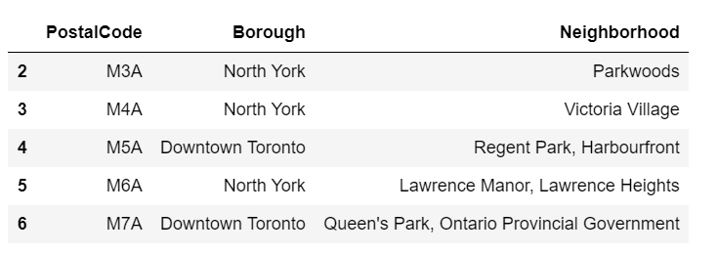
Example of data-set from origin

Slide 5
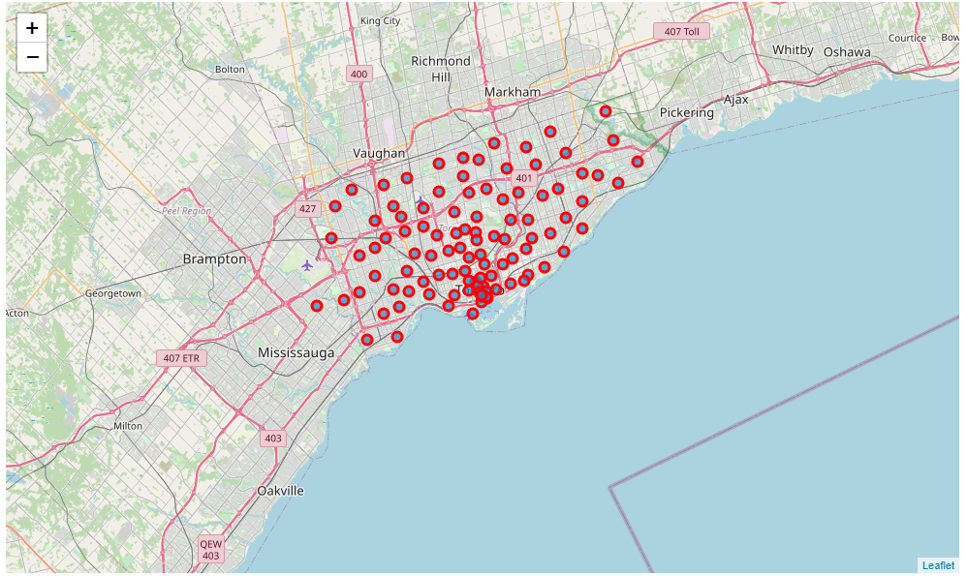
Plotting of available points
Another data set was used for combining postalcodes with latitude and longitude of the data
Map for datapoints available—

Slide 6
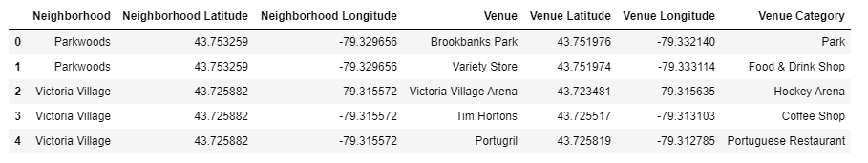
Final Dataset for analysis and clustering
Finally using foursquare API we created dataset including neighbourhoods, venue name, venue category and it’s coordinates for analysis.

